Slide 1

1e themabijeenkomst wiskunde
Een Aha-erlebnis
Roel Jansen
Docent Werktuigbouwkunde
Notes:
Roel Jansen trapt de reeks af met een interactieve workshop over het gebruik van wiskunde bij praktijkonderzoek in de techniek. Hij is docent-onderzoeker bij de Academie Engineering & Automotive van de Hogeschool van Arnhem en Nijmegen.

Slide 2
INHOUD WORKSHOP
Wat is een Aha-erlebnis?
Mijn eigen Aha-erlebnis
  Versnellingen integreren
  Digitale beelden verwerken
Notes:
Een aha-erlebnis, letterlijk aha-ervaring, is een situatie waarin een persoon plotseling nieuwe inzichten verkrijgt. In zo’n situatie is men vaak geneigd "aha!, dus dat zit zo", of "aha!, zo kan het dus ook" te denken. De uitdrukking is Duits, maar in het Nederlands ingeburgerd.

Slide 3
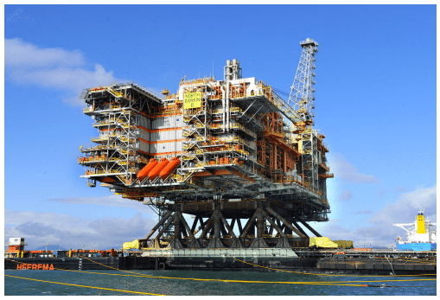
Mijn 1e Aha-erlebnis
Bron: https://gcaptain.com/loads-worlds-largest-offshore/

Slide 4
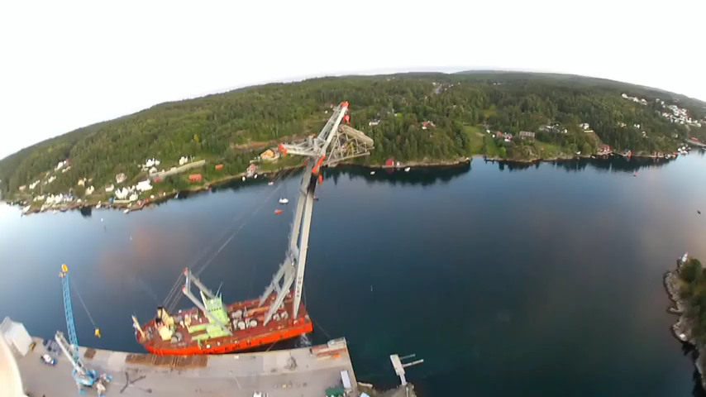
Notes:
1e afgeleide is de helling
Statoil, omzet 100 miljard US$

Slide 5
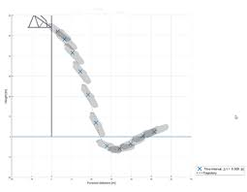
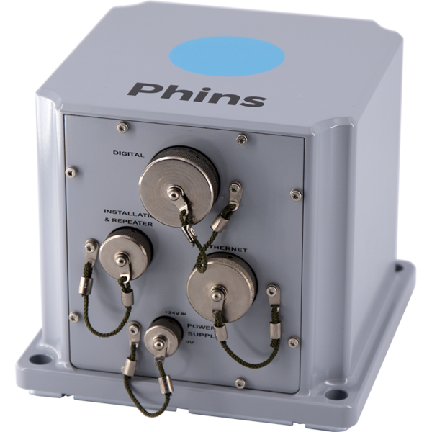
Dubbel integreren van versnelling
Rechtlijnige versnellingen
Rotatie versnellingen
Notes:
Hier zie je de versnellingssensor welke aan boord is. Deze meet rechtlijnige versnellingen in x, y en z richting. Daarnaast worden hoekversnellingen, ookwel rotatieversnellingen gemeten. Door dubbel te integreren krijg je de hoeken. Hieruit kun je de positie van de boot bepalen. En bepalen of deze op tijd voldoende afstand van het brandend platform heeft.

Slide 6
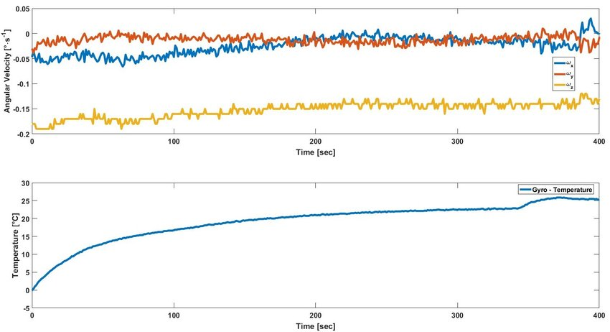
Ruis

Slide 7
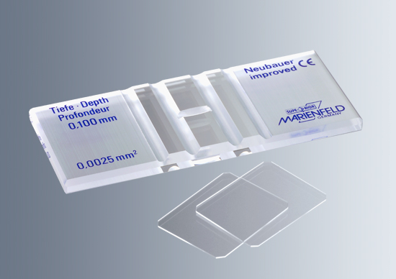
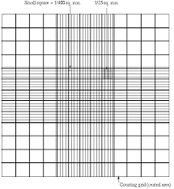
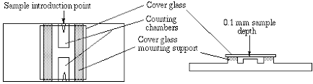
Mijn 2e aha-erlebnis

Slide 8
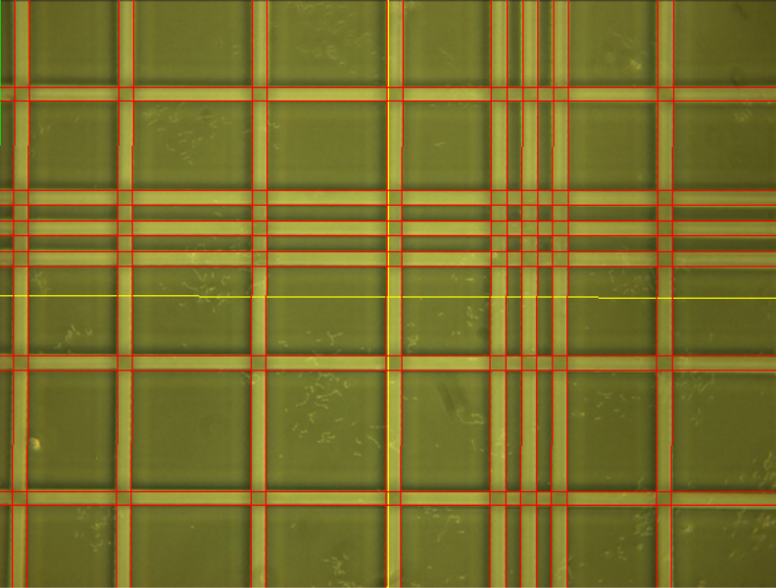
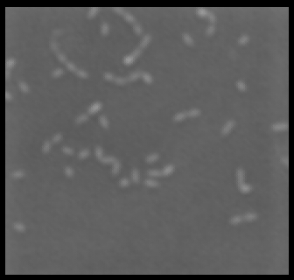
Mijn 2e aha-erlebnis

Slide 9
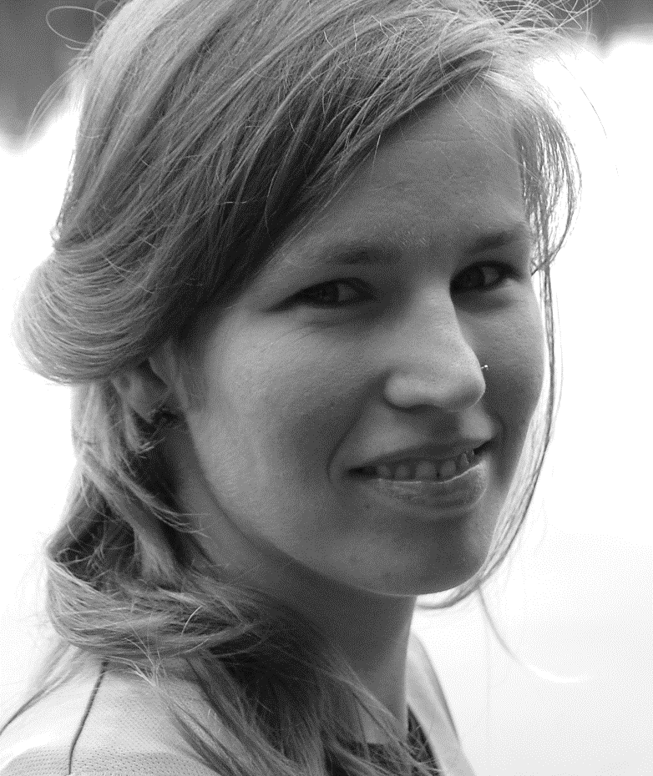
Grijswaardes
0 - 255
17 | 12 | 14 | 15
16 | 13 | 11 | 88
10 | 12 | 99 | 92
11 | 88 | 92 | 98

Slide 10
Mijn 2e aha-erlebnis
Stap 1: randen opsporen
Een ideale rand
Meer realistisch

Slide 11
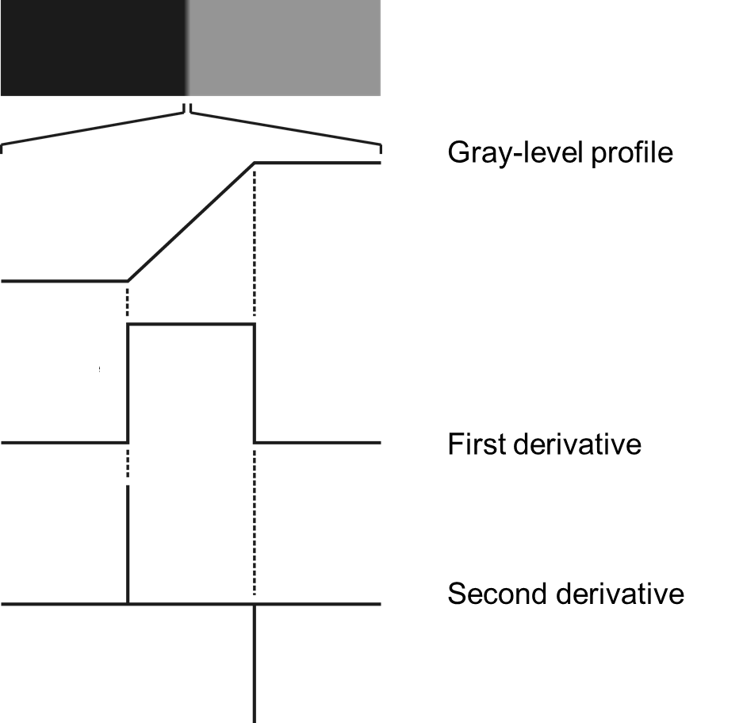
Mijn 2e aha-erlebnis
1e en 2e afgeleide
Grijswaarde profiel
1e afgeleide
2e afgeleide
Notes:
Canny-Deriche, Lanser, and Sobel edge detectors; facet model and Steger line detectors with an accuracy of up to 1/50 pixel; subpixel color edge and line detectors; subpixel threshold.

Slide 12
Mijn 2e aha-erlebnis
Meer realistisch, ruis (sigma = 0.001)
Origineel
1e afgeleide
2e afgeleide
Notes:
The edges in the previous slides were noise-free. When the input image is corrupted by noise, the first and second derivatives respond quite differently. Even modest noise levels – barely noticeable when you look at the original image or its profile- can render the second derivative results useless, whereas more pronounced noise levels will also impact the first derivative results to a point that they cannot be used for edge detection.

Slide 13
Mijn 2e aha-erlebnis
Nog Meer realistisch, ruis (sigma = 0.001)
Origineel
1e afgeleide
2e afgeleide
Notes:
The edges in the previous slides were noise-free. When the input image is corrupted by noise, the first and second derivatives respond quite differently. Even modest noise levels – barely noticeable when you look at the original image or its profile- can render the second derivative results useless, whereas more pronounced noise levels will also impact the first derivative results to a point that they cannot be used for edge detection.

Slide 14
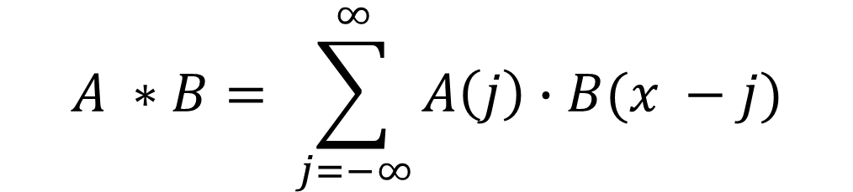
1-D convolutie
De convolutie van twee rijtjes getallen, A(x) and B(x), wordt gegeven door A * B, wordt wiskundig beschreven via onderstaande vergelijking:
$$A ∗B= \sum_{j=−∞}^{∞}{A\left(j\right)∙B(x −j)}$$
Notes:
http://colah.github.io/posts/2014-07-Understanding-Convolutions/

Slide 15
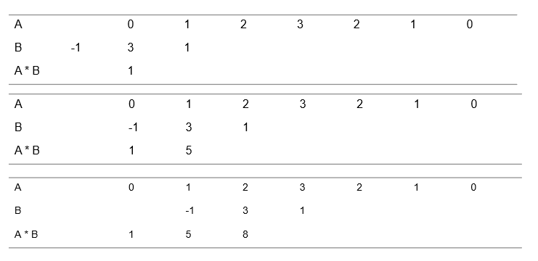
EEN VOORBEELD
  A = {0, 1, 2, 3, 2, 1, 0}
  B = {-1, 3, 1}
Notes:
In this example, we show how the result of a 1D convolution operation can be obtained step-by-step. Let A = {0,1,2,3,3,1,0} and B = {1,3,-1}. The partial results of multiplying elements in A with corresponding elements in B, as B shifts from minus infinity to infinity are displayed.
Initially, we mirror B and allign its center (reference) value with the first (leftmost) value of array A.

Slide 16
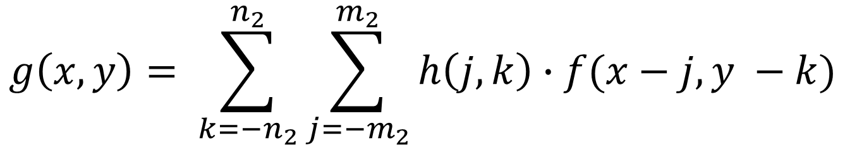
CONVOLUTION AND CORRELATION
2-D convolution
$$g\left(x,y\right)= \sum_{k={−n}_{2}}^{n_{2}}{\sum_{j={−m}_{2}}^{m_{2}}{h\left(j,k\right)∙f(x−j,y −k)}}$$
Notes:
where m2 is equal to half of the mask’s width and n2 is equal to half of the mask’s`height

Slide 17
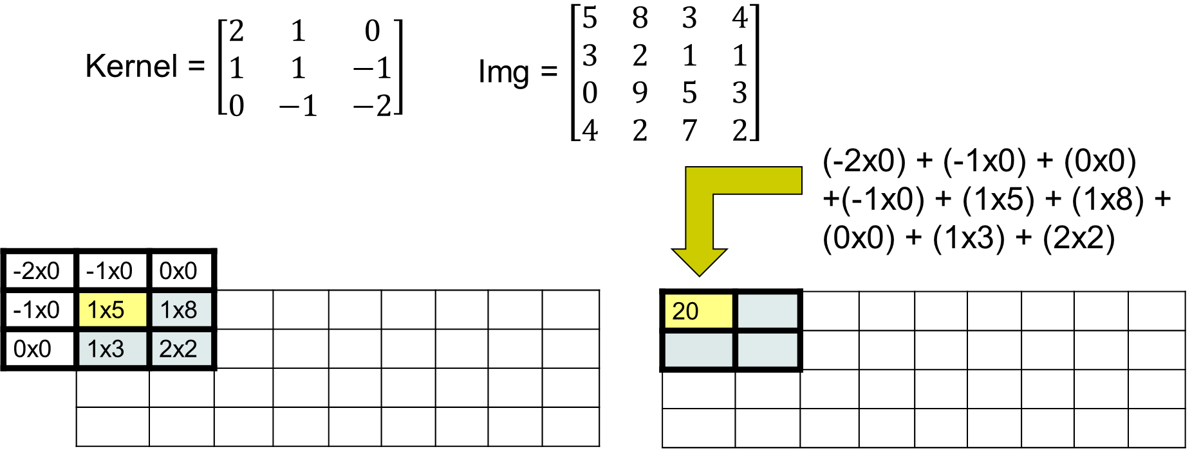
EEN VOORBEELD

Slide 18
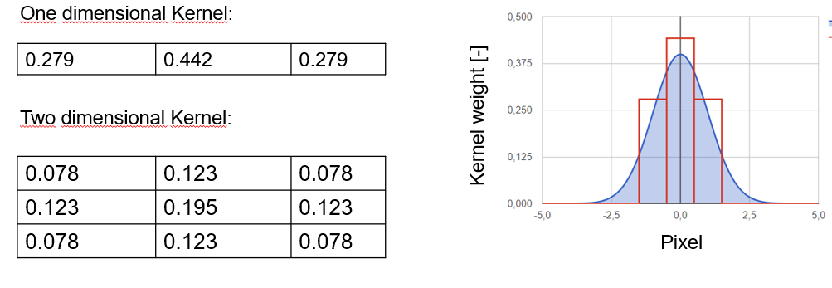
INVULLING VAN HET KERNEL
1D Gaussisch Kernel:
1D Gaussisch Kernel:
Notes:
The Gaussian blur filter is the best-known example of a LPF implemented with a nonuniform kernel. The mask coefficients for the Gaussian blur filter are samples from a 2D Gaussian function.
The parameter sigma controls the overall shape of the curve: the larger the value of sigma, the flatter the resulting curve.
Source: http://dev.theomader.com/gaussian-kernel-calculator/

Slide 19
Mijn 2e aha-erlebnis

Slide 20
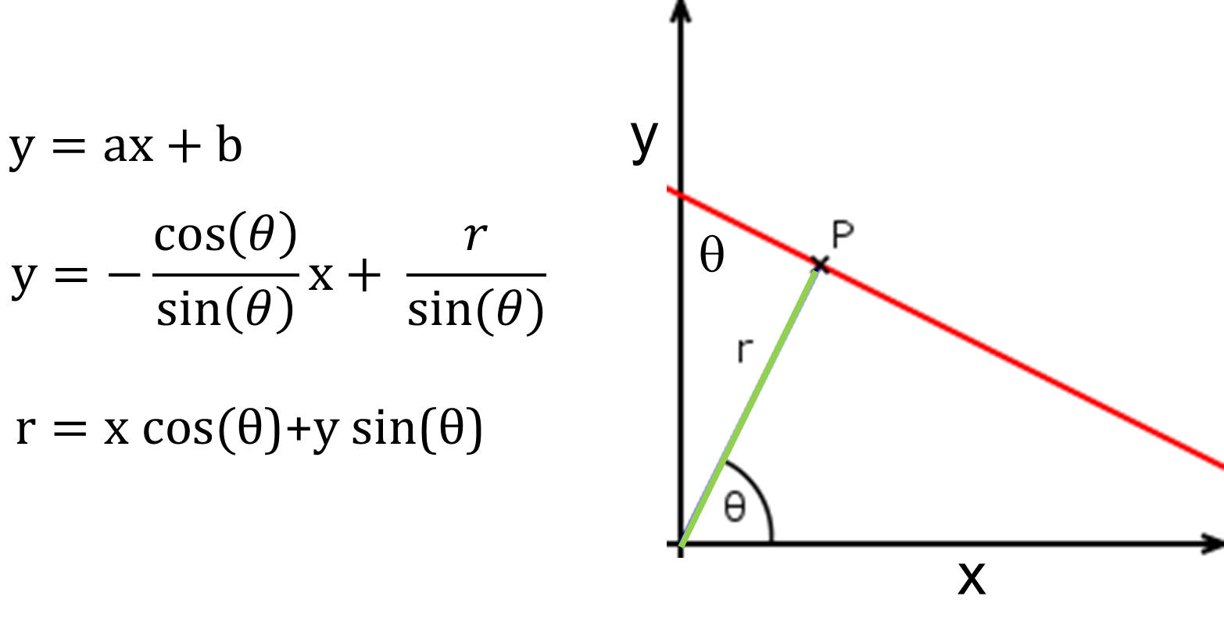
DE HOUGH TRANSFORMATIE
Cartesiaans naar polair coördinaten stelsel
Notes:
The general formula of a line is the well-known equation, where a denotes the slope, while b is the point where the line crosses the y-axis. Although this is a simple and easy-to-use formula, vertical lines cannot be described with it. Now have a look at the following image:
Here a polar coordinate describes the line: r is the distance of the origin and the line, while θ is the angle of the vector pointing from the pole to the closest P point of the line. Using these notations, the equation of the line becomes the following:
a = delta y / delta x
x,y = cartesisch coordinaten stelsen
Suppose, that we have an arbitrary P point on an image. To get all possible lines going through it, simply rotate a line crossing P from 0 to 180 degrees: as θ changes r will change too.

Slide 21
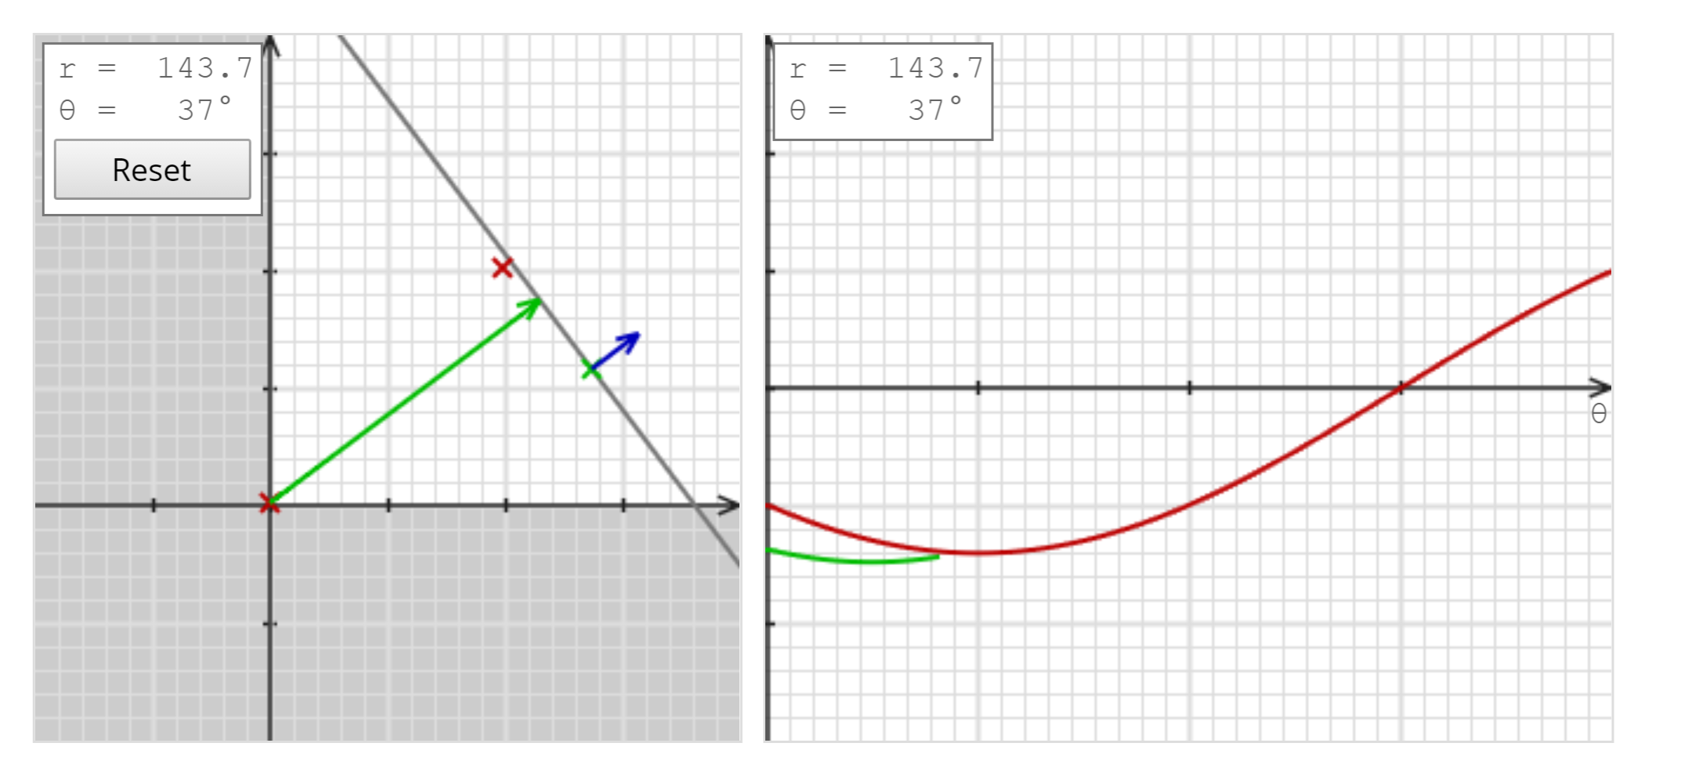
DE HOUGH TRANSFORMATIE
Notes:
The general formula of a line is the well-known equation, where a denotes the slope, while b is the point where the line crosses the y-axis. Although this is a simple and easy-to-use formula, vertical lines cannot be described with it. Now have a look at the following image:
Here a polar coordinate describes the line: r is the distance of the origin and the line, while θ is the angle of the vector pointing from the pole to the closest P point of the line. Using these notations, the equation of the line becomes the following:
a = delta y / delta x
x,y = cartesisch coordinaten stelsen
Suppose, that we have an arbitrary P point on an image. To get all possible lines going through it, simply rotate a line crossing P from 0 to 180 degrees: as θ changes r will change too.

Slide 22
Mijn 2e aha-erlebnis

Slide 24
CONCLUSIE
WISKUNDE = ESSENTIEEL
WISKUNDE = ESSENTIEEL
WISKUNDE = ESSENTIEEL

